Slide 1

Miguel Torrealba Schwarz
Advanced Programming OIM 7502 Midterm Project

Slide 2
Agenda
Introduction to SciPy
Installation
Key Functionality
Tutorial
Code Examples
Conclusions

Slide 3
Introduction to SciPy
What is it?
Open-source library for mathematics, science, and engineering.
Travis Olliphant (1990s), an American data scientist
Designed to be a toolkit for scientific computing tasks
Built on top of NumPy and provides additional functionality.
Includes modules for optimization, integration, interpolation, eigenvalue problems, signal and image processing, statistics, and others.
Why is it important for Data Scientists?
Enables scientific and technical computing functions
Data scientists often leverage for:
Statistical Analysis
Optimization
Signal and Image Processing:
Numerical Integration
Linear Algebra
Machine Learning
Notes:
Data scientists often leverage SciPy for:
Statistical Analysis: Hypothesis testing, descriptive statistics, and probability distributions
Optimization: Fine-tune parameters and optimize functions
Signal and Image Processing: Filtering, convolution, Fourier analysis, and other
Numerical Integration: Computing definite integrals (common in scientific simulations)
Linear Algebra: matrix operations (relevant to data analysis)
Machine Learning: optimization and linear algebra modules are crucial components

Slide 4




Installation
1) Command: initiate the installation process (usually downloads its dependencies)
%pip install scipy
2) Depending on the system and configurations, it may be needed to install the additional libraries (NumPy & Matplotlib)
%pip install numpy matplotlib
3) Once installations are complete, we import the library, and therefore verifying everything it was properly downloaded
import scipy
4) If there are no errors, SciPy is ready to be used

Slide 5

Key Functionality
Numerical Integration: allowing precise calculations of definite integrals.
Optimization: optimization algorithms for finding the minimum or maximum of functions
Linear Algebra: extends NumPy's linear algebra capabilities, providing additional tools for solving linear systems, eigenvalue problems, and more.
Signal and Image Processing: Filtering, Fourier analysis, convolution, and image processing are available, catering to tasks in signal processing and computer vision.
Statistical Functions: provides a wide range of statistical functions and probability distributions, crucial for statistical analysis and hypothesis testing.

Slide 6
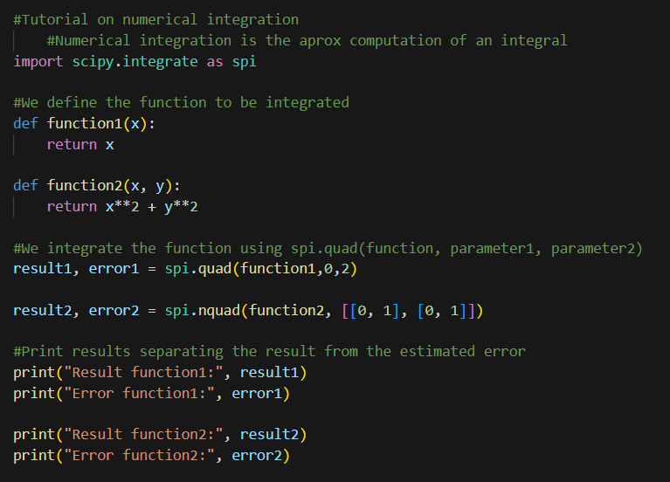

Tutorial Numerical Integration
Code
Highlights
Using SciPy, we will compute a definite integral of a function from a to b
This will return 2 values:
Value of the integral
Estimate of absolute error of the integral
The use of quad (1 variable) and nquad (+1 variables)
Result are as followed:

Slide 7
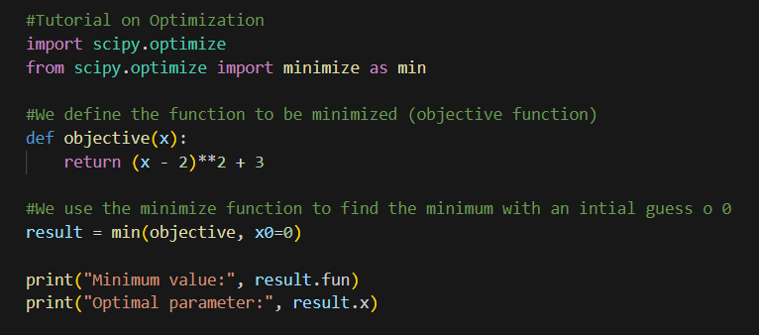

Tutorial Optimization
Code
Highlights
Using SciPy's optimization tools, we will find the minimum of the objective function.
This will return 2 values:
Minimum Value (of the function)
Optimal parameter (value for the minimum value)
You can add constraints if defined as functions before
Result are as followed:

Slide 8
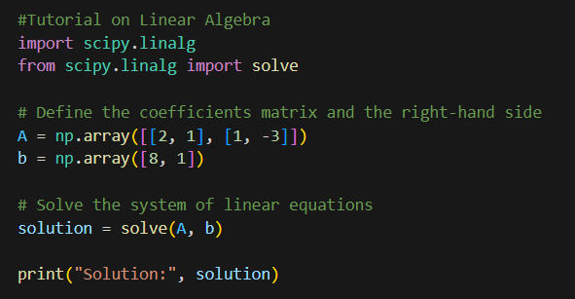
Tutorial Linear Algebra
Code
Highlights
SciPy extends NumPy's linear algebra capabilities, providing additional tools for solving linear systems, eigenvalue problems, and more.
This will return 2 values:
Value of the integral
Estimate of absolute error of the integral
The use of quad (1 variable) and nquad (+1 variables)
Result are as followed:

Slide 9
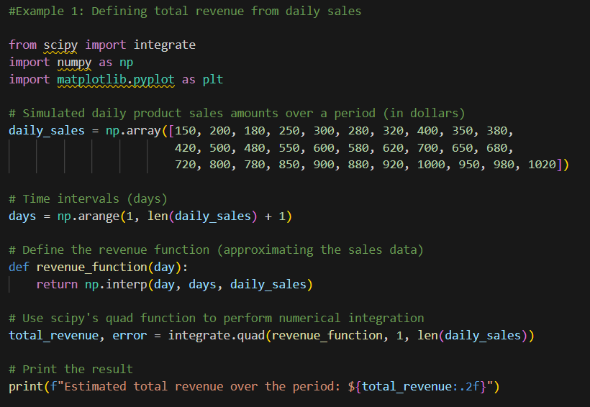
Code Example 1 Total Sales
Problem
Code
Assume you have a list of daily sales amounts (in dollars) over 30 days, and you want the plot of integrated revenue, which is useful for:
Total Revenue Estimation
Trend analysis
Seasonal patterns (evident)
Decision Support
Day 1: 150
Day 2: 200
Day 3: 180
Day 4: 250
Day 5: 300
Day 6: 280
Day 7: 320
Day 8: 400
Day 9: 350
Day 10: 380
Day 11: 420
Day 12: 500
Day 13: 480
Day 14: 550
Day 15: 600
Day 16: 580
Day 17: 620
Day 18: 700
Day 19: 650
Day 20: 680
Day 21: 720
Day 22: 800
Day 23: 780
Day 24: 850
Day 25: 900
Day 26: 880
Day 27: 920
Day 28: 1000
Day 29: 950
Day 30: 980
Day 31: 1020
Logic
Import libraries
Create an array with the daily sales using NumPy
Create an array representing days
Define a function that interpolates sales data to estimate the revenue on a given day. (make it continuous)
Integrate using quad with the period given and the function created

Slide 10
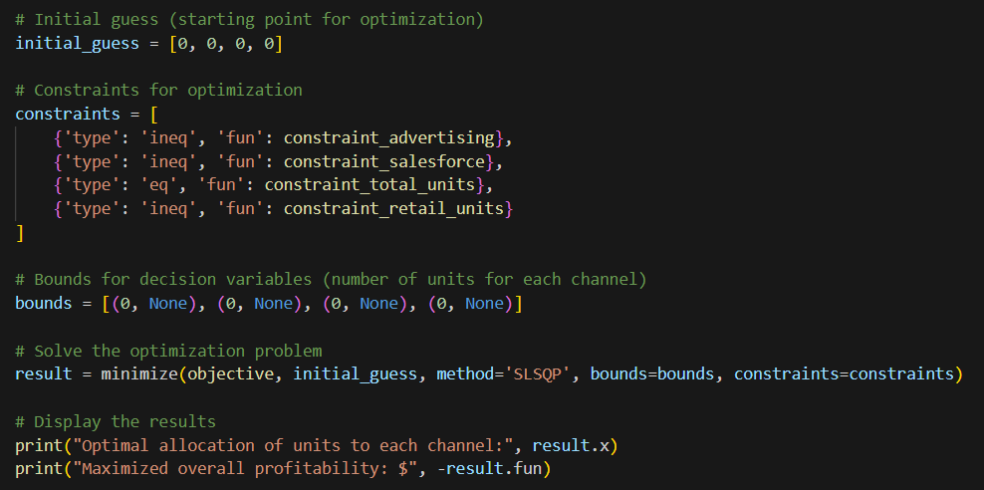
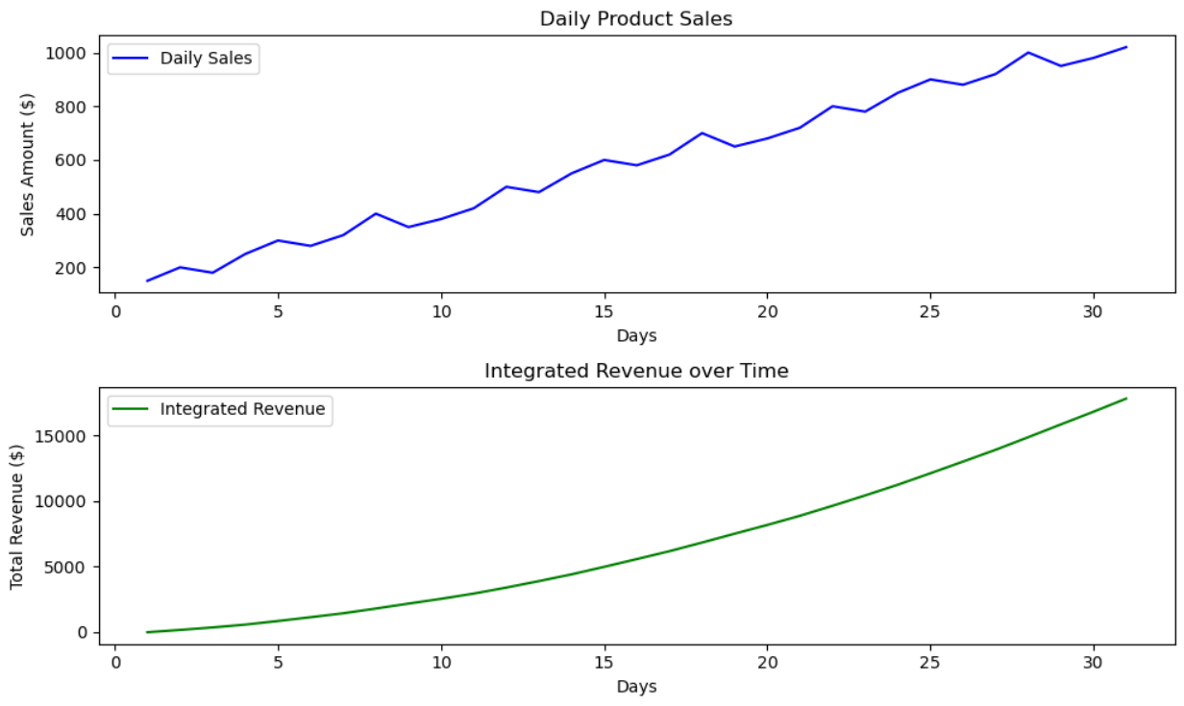
Code Example 1 Total Sales
Problem
Solution

Slide 11
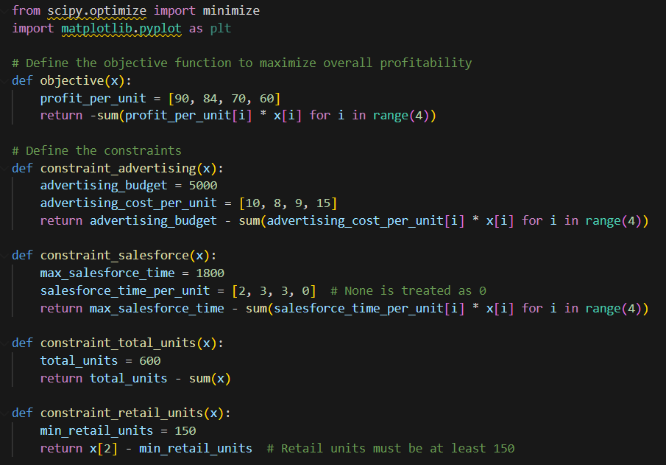
Code Example 2 Distribution
Problem
Code
Electronic communication
The firm has an advertising budget of $5000
Up to 1,800 hours of salesforce time
Management decided to produce exactly 600 units for the current period
Contract requires that at least 150 units be distributed through retail stores.
Distribution should maximize profitability of the new portable radio.
How many units must be allocated to each of the four distribution channels?
How to allocate the advertising budget and salesforce effort to each of the four distribution channels.
Formulation
OF
90*X1 + 84*X2 + 70*X3 + 60*X4
Subject to:
10*X1 + 8*X2 + 9*X3 + 60*X4 <= 5000
2*X1 + 3*X2 + 3*X3 <= 1800
X1+X2+X3+X4 = 600
X3 >= 150
X1, X2, X3, X4 >=0

Slide 12

Code Example 2 Distribution
Problem
Solution

Slide 13
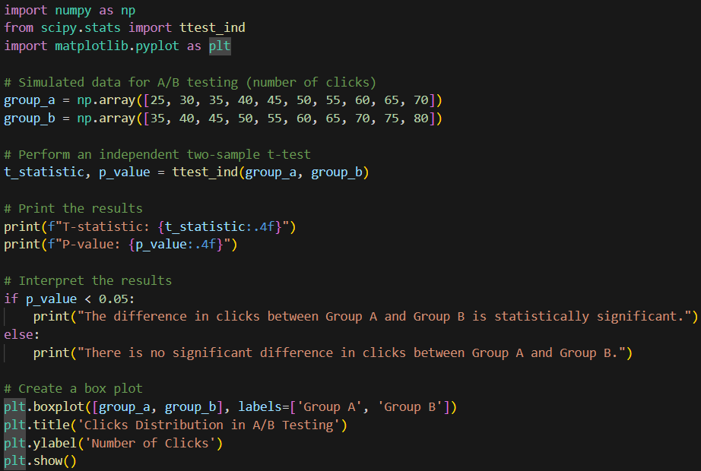
Code Example 3 A/B Testing
Problem
Code
The marketing team is interested in testing two different versions of a website to see which one leads to higher user engagement. You have collected data on the number of clicks from two groups:
Group A (the current website version)
25, 30, 35, 40, 45, 50, 55, 60, 65, 70
Group B (the new version).
35, 40, 45, 50, 55, 60, 65, 70, 75, 80
Logic
Import libraries: Import necessary libraries. numpy for numerical operations and ttest_ind from scipy.stats for the two-sample t-test.
Simulate data
Perform Two-Sample T-Test
Print the Results with interpretation
Graph box-plot for results

Slide 14

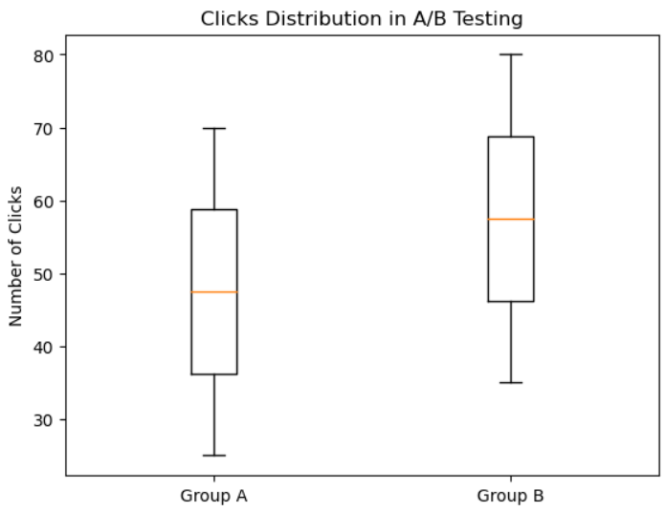
Code Example 3 A/B Testing
Solution
Interpretation
The medians are visibly different, it might provide a visual hint of a potential difference in the groups
However, in cases where the sample size is small and the p value show there is no significant difference in clicks between A & B

Slide 15
Conclusion
SciPy is an open-source scientific computing library built on NumPy to extend capabilities for optimization, integration, linear algebra, signal and image processing, and statistical functions
Considering the time passed and use since its creation, SciPy is well documented and has an active community for support, making it accessible for both beginners and experienced users
Useful for data science, considering it’s ready-to-use tools that are crucial for statistical analysis, optimization, and advanced numerical computations

